Slide 1
CSS
Cascading Style Sheets
By: Asif Shahzad

Slide 2
Introduction to CSS
CSS stands of Cascading Style Sheets, used to describe presentation or styles of web pages e.g.:
  Layout, color, font, borders, paddings, etc.
  Responsiveness – Mobile friendly user interfaces
World Wide Web Consortium W3C develop and publish CSS Specifications. The specification is used by web browsers, publishers and developers etc.
CSS can be embedded in HTML page or attached as an external CSS file.
How much CSS one should know: depends on objective e.g. front end developer, backend developer, full stack developer.
Notes:
Block and inline elements

Slide 3
Selectors
Rules/syntax to select page element/s to apply CSS properties.
Code structure to declare style or CSS properties:
  selector {property1: value1; property2:value2;…}
There are three basic types of selectors:
Tag Name, Tag ID, Tag Class
Examples:
  p {color: red;}
  #name {font-size:20px;}
  .alpha {font-family: arial;}
Some other selectors: nested/child, immediate child, universal, attribute, pseudo classes, pseudo elements, etc.

Slide 4
How to add CSS in HTML page
CSS can be added to HTML page using following ways:
  Inline Using style attribute of the element
  Internal Using <style> element, usually in <head> section
  External Using external CSS file. Link tag to used to attach external file.

Slide 5
Properties for Color, Size, Font
Color
  Background-color
  Color
Size
  Height
  Width
Font
  Font-family
  Font-size
  Font-weight
  Font-style
https://www.chromestatus.com/metrics/css/popularity
Notes:
TODO: adding external font and units details

Slide 6
Properties for Text you can skip them.. From exam perspective.
text-align
text-indent
line-height
(normal, number, unit length, %, initial, inherit)
word-spacing
letter-spacing

Slide 7
CSS Box Model
Elements are renders as rectangular box. Box size is calculated using following sizes:
    Content
    Padding
    Border
    Margin*
By default, specified width and height belong to content area. We can set to border-to-border (inclusive) using:
box-sizing: border-box;
Notes:
To-do: add slide to show it graphically

Slide 8
Padding, Border and Margin
Padding:20px
  Padding-left
  Padding-top
  Padding-right
  Padding-bottom
Margin
  Margin-left
  Margin-top
  Margin-right
  Margin-bottom
Border
  Border-width:20px;
  Border-style
  Border-color
  OR
  Border-left-width
  Border-left-style
  Border-left-color
  .
  .

Slide 9
Positioning
  Static - Its default. Elements aren’t positioned
  Relative - Elements are placed relative to their default position. It occupies the original space on canvas, so incorrect use may effect other elements’ visibility.
  Absolute
    Remove the element from document flow and places as per position specified w.r.t. page. It do not occupy the original space.
    To position w.r.t. container, container must be positioned (relative, absolute, or fixed).
  Fixed - With ref. to viewport (browser window), stays on scroll
  Sticky - Acts like relative until a certain scroll position is hit, then it sticks like fixed, until its nearest (scrollable) ancestor go out of viewport.
Notes:
To-do: add slide to show where positioning is useful, graphically.
Absolute and fixed positioned elements loses the dimension. We need to give width, height.

Slide 10
Flex Container Props
flex-direction
  4 options
  row | column | row-reverse | column-reverse
  E.g. flex-direction: row;

Slide 11
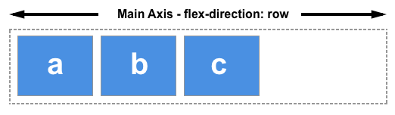
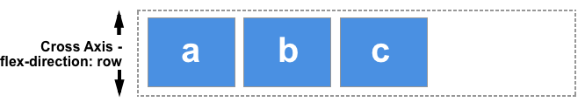
flex-direction: row

Slide 12
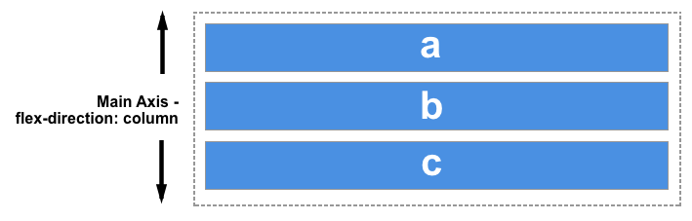
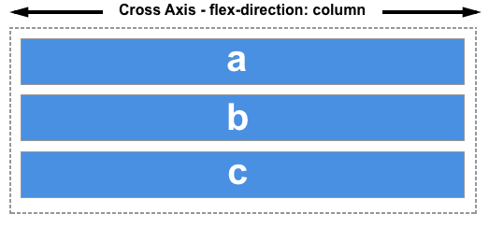
flex-direction: column

Slide 13
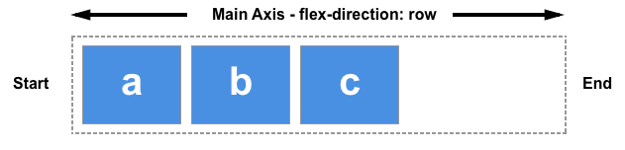
start and end - not left and right

Slide 14
Flex Container
Direct children of flex container are called flex items.
If we do not specify flex-direction, items display in a row.
Items placement start from start edge of the main axis. See 1x.html
Items do not stretch on the main axis, but at cross axis.
see 1x.html and 1x2.html

Slide 15
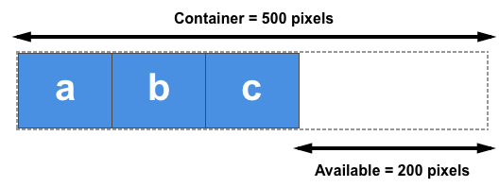
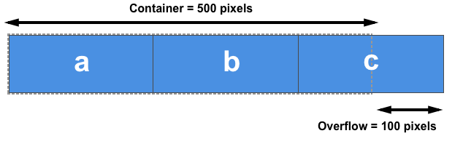
Positive and Negative Free Space

Slide 16
Flex Container Basic Props
justify-content
  Its for main-axis
  Divide available space between items. See 2x.html

Slide 17
Flex Container Basic Props
align-items
  align-items property work in cross axis.
  Think of it, justify-content version for the cross-axis.
  There must be some free pace in cross axis.
  see 3x.html
  If there is space in cross axis, and you do not specify the align-items, the items would stretch at cross axis.

Slide 18
Flex Container Basic Props
flex-wrap
  By default, items do not wrap in cross axis when container is resized, or screen size is small.
  Default value is nowrap see 4x.html
  Container cross-axis size automatically increase/decrease, depending on space required by items.

Slide 19
Flex Item - Basic Props
flex-grow
  It defines, how the free positive space should be distributed inside the items.
  Default value 0, so items do not grow by default.
  If you want items to grow up to a fixed pixel limit and then distribute the remaining space b/w items, use justify-content with flex-grow and set a max-width
  See 7x.html

Slide 20
Flex Item - Basic Props
flex-shrink
  It defines how the negative free space should be extracted from items to fit inside container.
  Default value 1 i.e. items shrink by default.
  See 8x.html

Slide 21
Flex-basis impact on item-size
flex-basis sets the initial main size of a flex item.
flex-basis:auto (default)
  If width/height is set, its the base size of item.
  If not set, fall back to content-size (its the base size)
flex-basis:0
The base size is treated as 0, ignoring content size and width/height. So, when width and basis both are set, basis take priority.

Slide 22
Media Queries
Media Queries help in making responsive design.
We can apply conditional CSS on elements e.g. apply certain CSS properties if screen width is greater than certain pixels.

Slide 23
Background Image Properties
background-image
background-repeat
background-position
background-attachment
Notes:
https://projects.verou.me/css3patterns/#

Slide 24
Styling Hyperlinks
Link States
  Link
  Visited
  Hover
  Active
Link state properties
  A:Link
  A:Visited
  A:Hover
  A:Active

Slide 25
Website Layout
Template or structure of a website. All pages generally follow common layout for quality user experience.
Table and div tags can be used to implement layouts
Tables objective is not layout creation
  Tables are mostly used for tabular data
  Creates code smell for complex templates
  Consumes more bytes of markup
We prefer div over table for layout
Flex and position are important properties to make div based layouts

Slide 26
Styling Lists
How to style ordered and unordered lists?
list-style-*
  type (none, disc, circle, square, etc.)
  image (url(‘image-name.ext’))
  position (outside, inside, initial, inherit)
  List-style-* properties using single line:
  list-style: circle url("texture.jpg") inside;
Notes:
Other style types: http://www.w3schools.com/cssref/pr_list-style-type.asp

Slide 27
Creating Navigation Bar using List
We can create navigation bars and drop down menus using list tag (i.e. ul, ol), by applying CSS properties
Remember following points from inline and block elements topic:
  We can’t apply top and bottom margins, width and height properties to inline elements
  Default ‘display’ of li tag is list-item. We must override to bring list items in single row.
  Use inline-block to apply sizing properties on inline elements
Notes:
Other style types: http://www.w3schools.com/cssref/pr_list-style-type.asp

Slide 28
Floats – 1 of 4
Block elements take 100% width of container (when width is not specified). They do not allow elements on right or left [1].
Float property changes the way a block element is laid out by the browser. These are taken out of the normal flow and then placed back following some rules.
Float property can be applied to block elements e.g. div, p, etc. Float applies with respect to container. Usage: float:right; float:left [2_0 to 2_1]

Slide 29
Floats – 2 of 4
Floated block elements shift to above row, when space is available. If there is not enough space, elements are shifted down automatically [2_2].
One element properties, may effect the others in layout.
Container fails to calculate height when it contains floated elements only. We apply some CSS to force container draw itself correctly. [2_3 and 2_4]

Slide 30
Floats – 3 of 4
Block elements before a floated element do not effect [3_0]. But when upper element is applied float property, bottom non-floated elements would wrap around [3_1] i.e. float my effect, non-floated elements.
If bottom elements are also floated, they would shift below when content is large [3_2]. Use width with floated elements [3_3] for predictable behavior.
If you want to stop non-floated elements to wrap around the floated elements, you need to clear the float. [3_4]

Slide 31
Floats – 4 of 4
‘Clear’ forces the element to shift down, even when it can adjust. clear:left allows no element be placed on left. clear:right allows no element be placed at right. To make both sides clear, use clear:both [3_4, 3_5]. Remember box model, see [3_5] again
While content will wrap - border, background image and background color will extend underneath [4_1].

